Slide 1

Java for Beginners
Level 6
Mr. Teasdale

Slide 2
Levels of Java coding
1: Syntax, laws, variables, output
2: Input, calculations, String manipulation
3: Selection (IF-ELSE)
4: Iteration/Loops (FOR/WHILE)
5: Complex algorithms
6: Arrays/Linked Lists
7: File management
8: Methods
9: Objects and classes
10: Graphical user interface elements

Slide 3
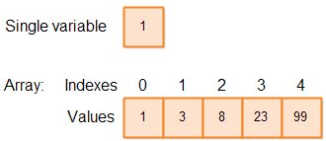
Arrays vs Variables

Slide 4
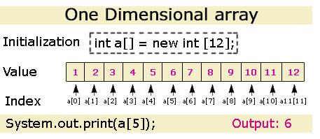
Initialising an array

Slide 5
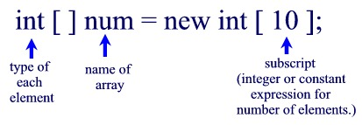
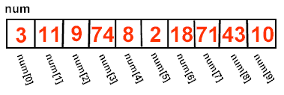
 | What could go wrong?
num [ 0 ] | always OK
num [ 9 ] | OK (given the above declaration)
num [ 10 ] | illegal (no such cell from this declaration)
num [ -1 ] | always NO! (illegal)
num [ 3.5 ] | always NO! (illegal)

Slide 6
Array length
When dealing with arrays, it is advantageous to know the number of elements contained within the array, or the array's "length". This length can be obtained by using the array name followed by .length. If an array named numbers contains 10 values, the code numbers.length will be 10. ** You must remember that the length of an array is the number of elements in the array, which is one more than the largest subscript.
http://mathbits.com/MathBits/Java/arrays/Declare.htm

Slide 7
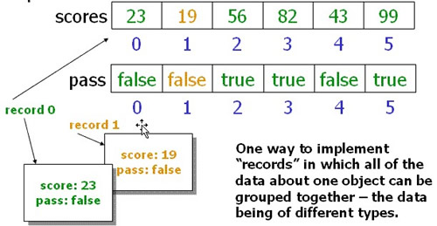
Parallel arrays

Slide 8
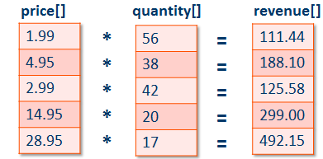
Parallel array applications

Slide 9
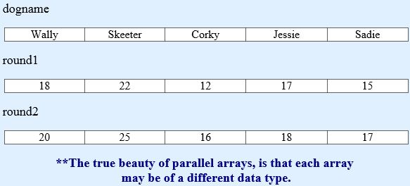
Parallel arrays in Java
for(int index = 0; index < dogname.length; index++) { System.out.println(dogname[index]); System.out.println(round1[index]); System.out.println(round2[index]); }

Slide 10
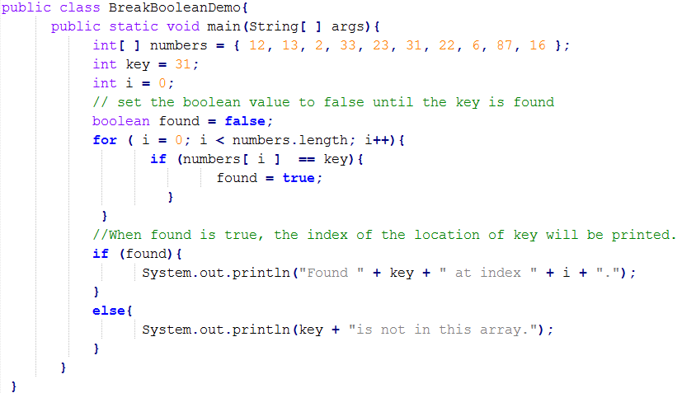
Searching an array using a flag
??

Slide 11
Searching an array using a flag

Slide 12
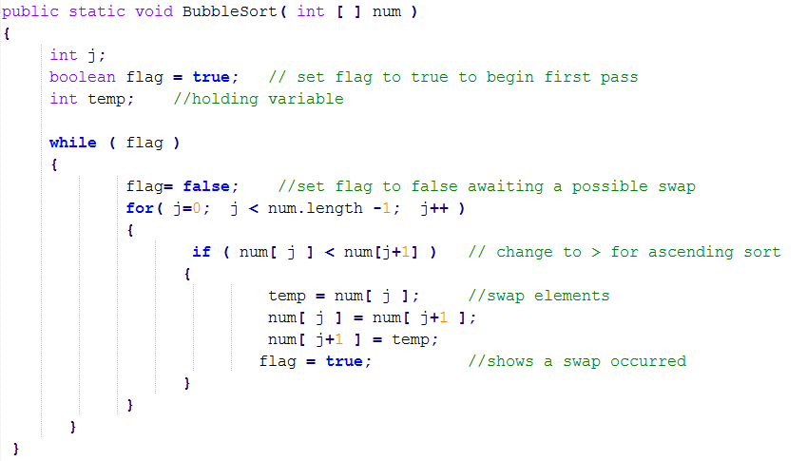
Sorting an array (Bubble Sort)

Slide 13
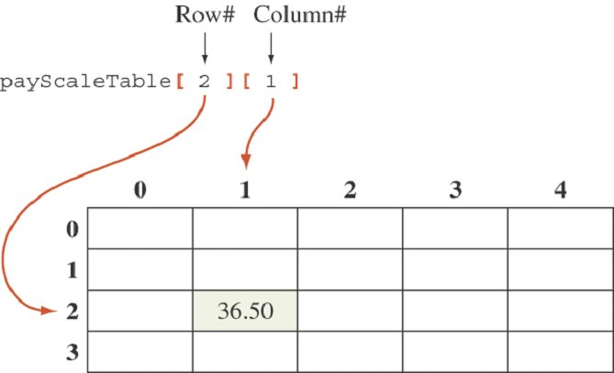
2D arrays

Slide 14
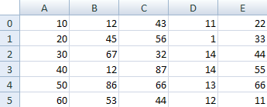
Declaring a 2D array in Java
int[ ][ ] arrNumbers = new int[6][5];
6 = number of rows (DOWN)
5 = number of columns (ACROSS)

Slide 15
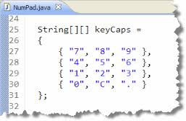
Instantiating a 2D array

Slide 16
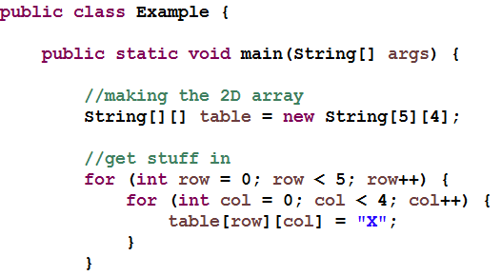
Example: Fill a 2D array with “X”
Output
Nothing!
You only put data in, not printed it!

Slide 17
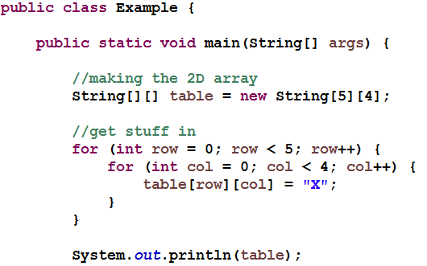

Common mistake: printing a 2D array
You can’t just print the array name,
You have to print every element in the array separately!
Output

Slide 18
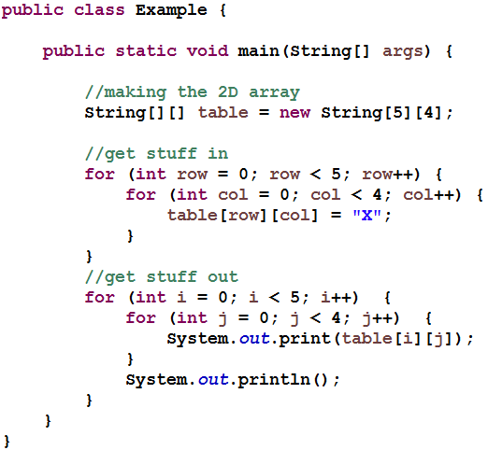
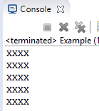
Correct way: printing a 2D array
Output

Slide 19
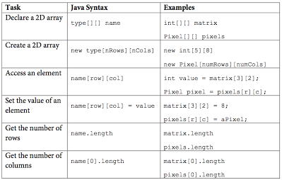
Common 2D array tasks

